Slide 1
CBO/ Community Leader Workshop
Pacific Islander Health Board of Washington

Slide 2
Agenda
Welcome
PIHB Team Introductions
Updates of our work
Health Care Authority presentation on the After- Pregnancy Coverage (APC)
BSK presentation on the work they do and programs they have for the community
PIHB youth program presentation on Behavioral Health
Panel presentation on outreach and engagement
Open discussion, questions, comments
Closeout

Slide 3
PIHB Team Introductions

Slide 4
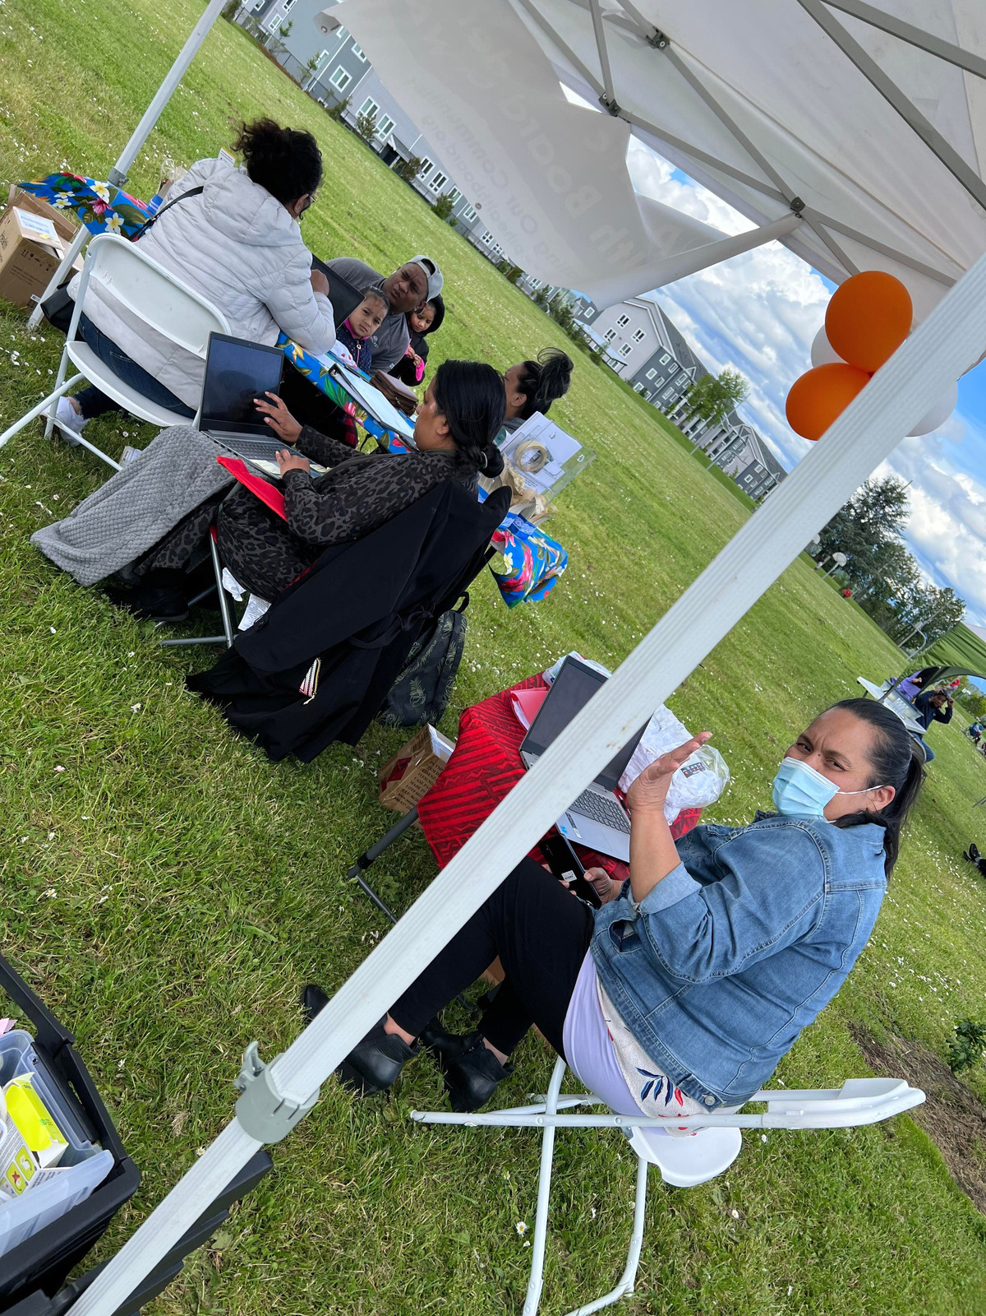
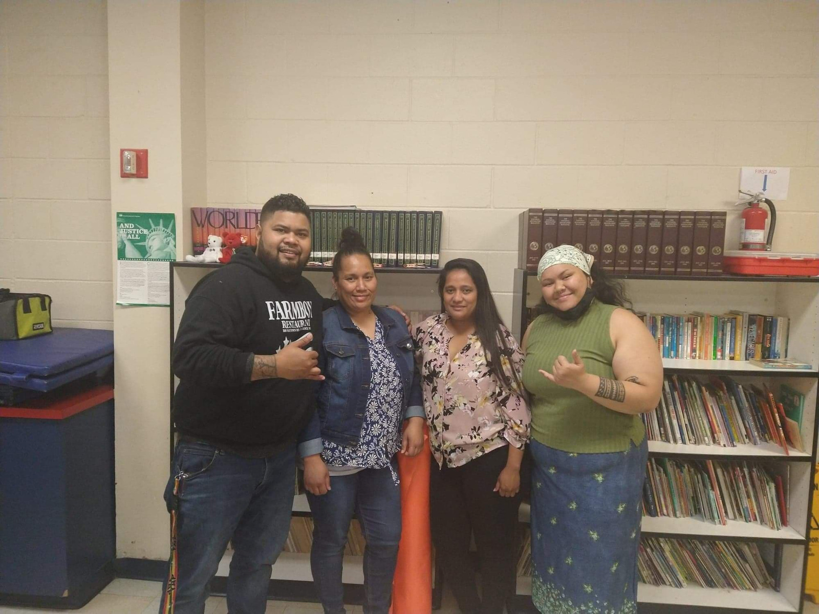
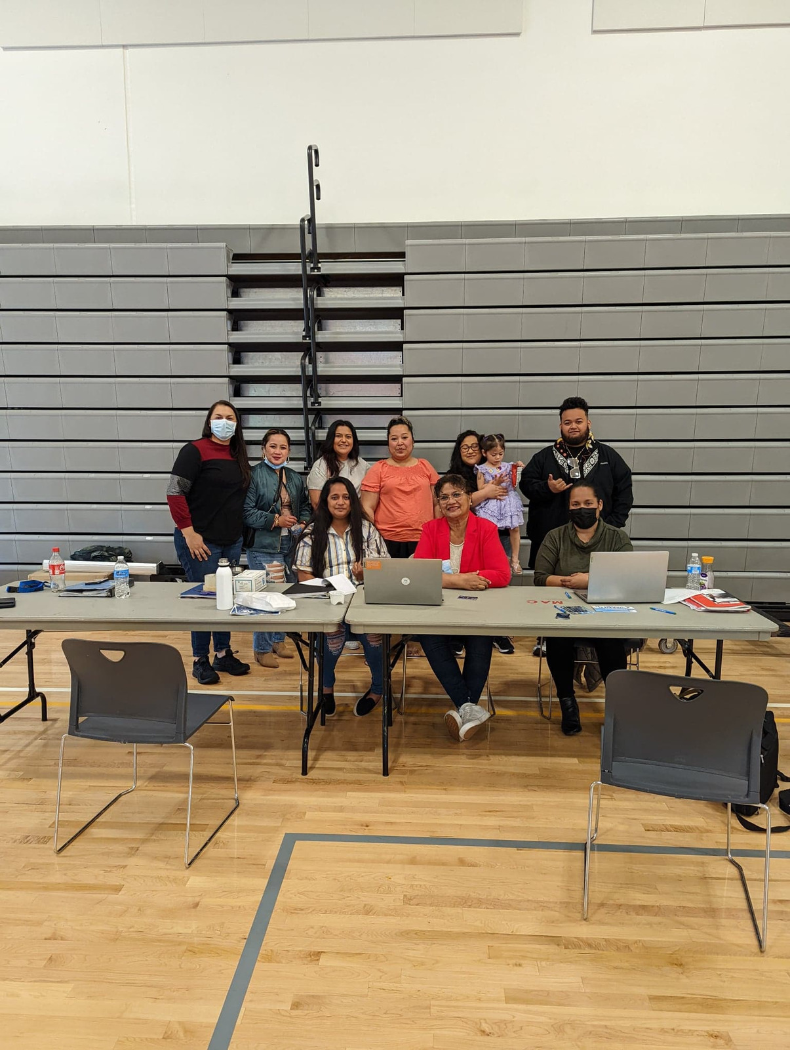
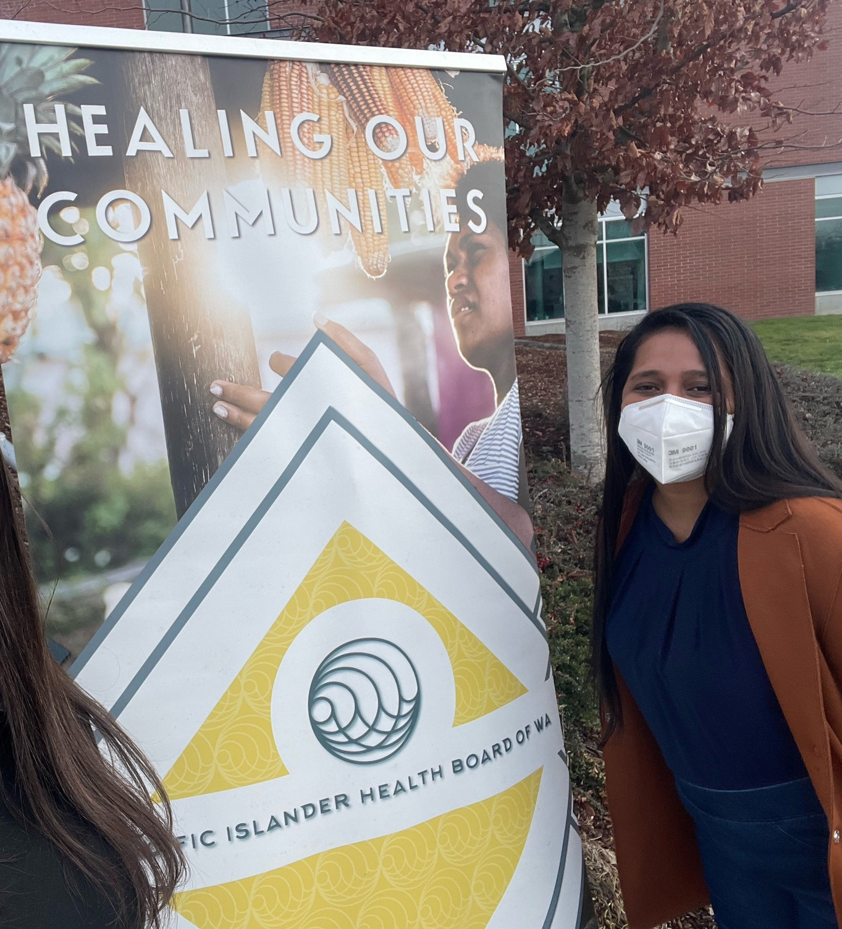
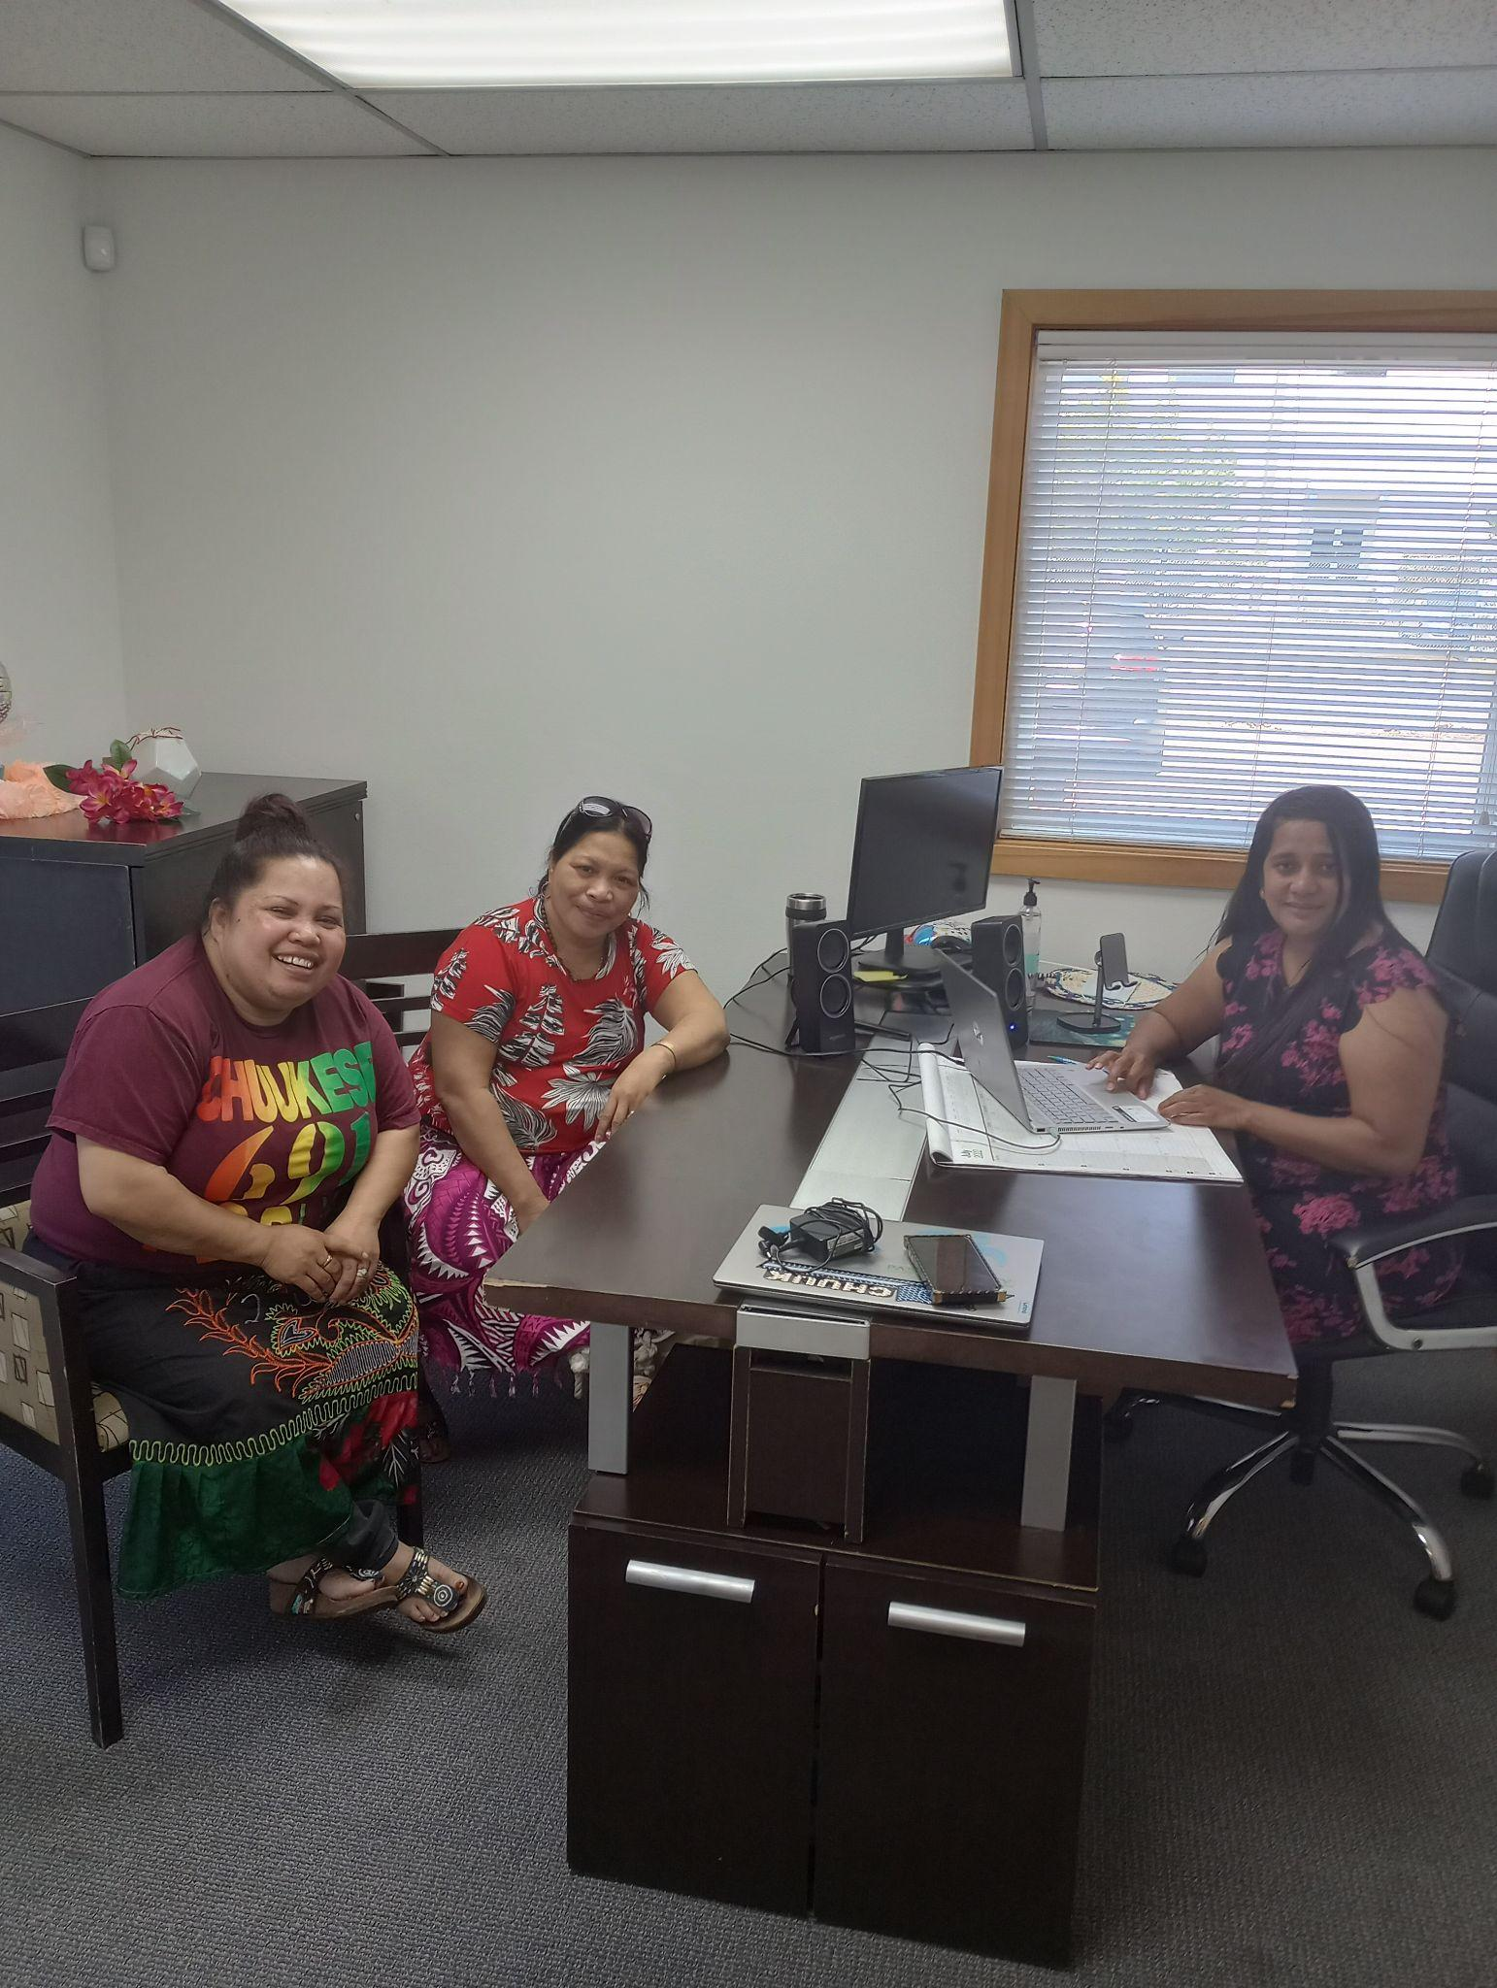
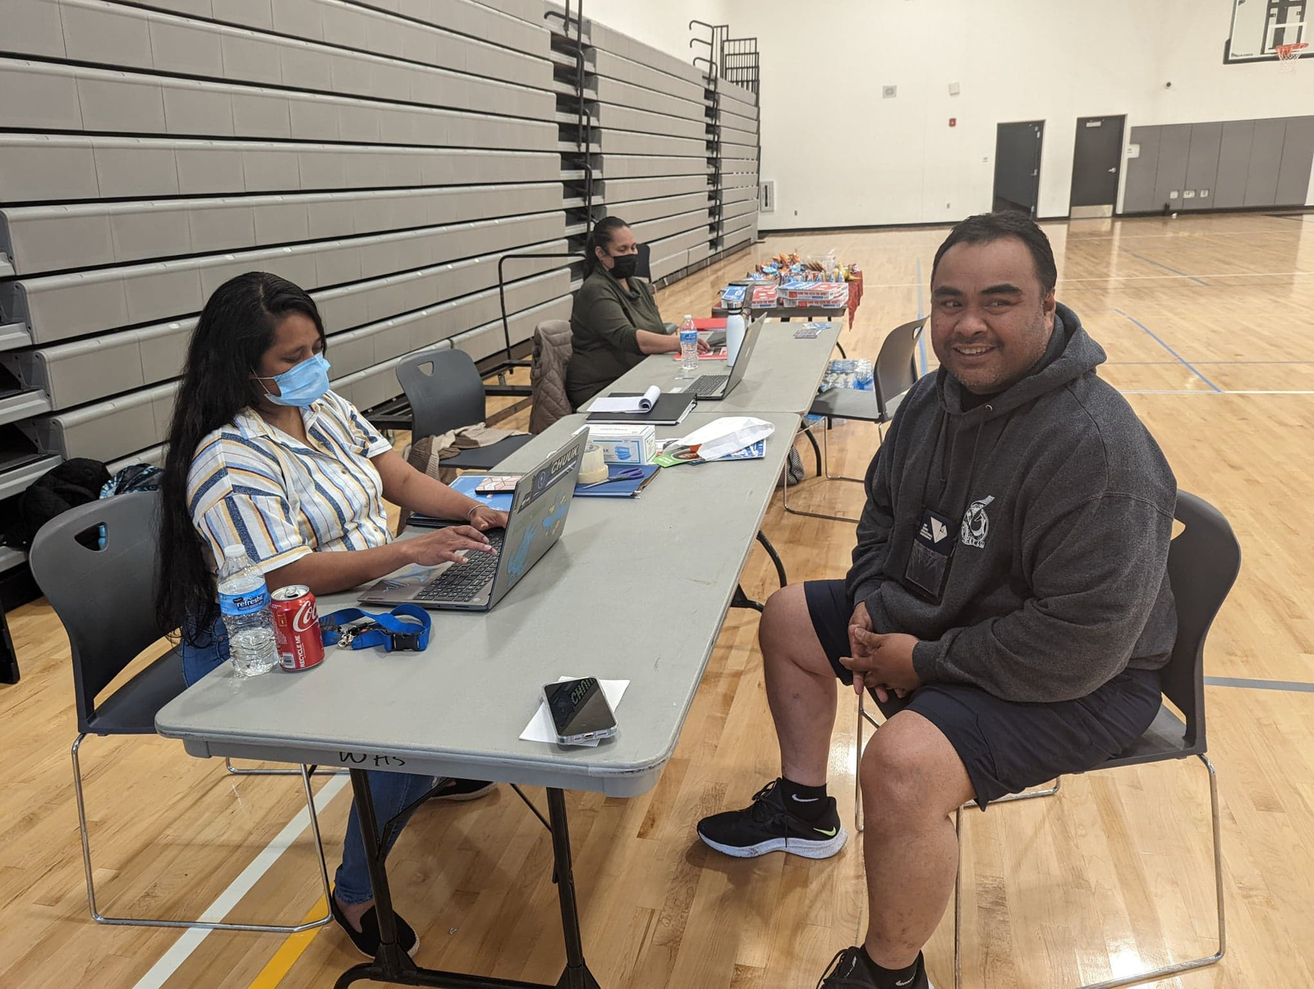
Open Enrollment Report
PIHB was able to go to 7 counties and enrolled 38 families during Open Enrollment.
We have also met with over 150 individuals throughout Washington State at our enrollment events!

Slide 5
Toll-free Line
Month | Calls Answered | Calls Returned
April 2022 | 41 | 0
May 2022 | 22 | 0
June 2022 | 54 | 0
July 2022 | 50
Community can call this line and get an interpreter in the 6 main COFA languages Monday through Friday 10am to 6pm
888-308-7113

Slide 6
Education Events

Slide 7
Progress
Our team do an education event series on Facebook Live and YouTube Live that took place January to April 2022
The education series covered the following topics, based on what we saw as the gaps in learning during open enrollment:
What is Apple Health (Medicaid)?
You Qualify for Apple Health, What’s Next?
How to Approach Problems with Coverage
Renewing Your Coverage
Qualified Health Plans and COFA Islander Programs
Translations are available on YouTube and on our website

Slide 8
What is Apple Health?
Covered:
Why healthcare coverage is important to have
What is COFA
What is Apple Health
How to know if you are eligible
How to apply for Apple Health

Slide 9
You Qualify for Apple Health, What’s Next?
We covered:
Client Responsibilities
How to apply and make changes to your account
What are Managed Care Plans
How to select a Managed Care Plan
Provider One and Managed Care Plan Cards
How to find a provider
What to do if you receive unpaid medical bills
Healthplanfinder requested additional information

Slide 10
Approaching Problems with your Coverage
We covered:
Tax Information
What is Washington Apple Health
Issues
Washington Healthplanfinder Username and Password
How to update your information in Washington Healthplanfinder
How to provide additional information needed by the WA Health Benefit Exchange
Didn’t Receive or lost health plan cards
Transition from COFA Health to Apple Health
What to do if you receive a medical bill
How to find a provider
Who to contact with your concerns (contact list)

Slide 11
Renewing Your Coverage
What we covered:
1095 Form Information for Taxes
How to Update Information on the WAHealthPlanFinder
When to Renew
How to Renew
Renewing Late

Slide 12
Qualified Health Plans/COFA Islander Programs
We covered:
How to update your information in WAHealthplanfinder
1095-A Form (for filing taxes)
Contacting the PIHB team
What Is Open Enrollment
Special Enrollment
Qualified Health Plans
COFA Islander Programs

Slide 13
Lessons Learned
We played trivia to gauge understanding of content from the previous presentation
Usually someone could answer the question, however during “How to Approach Problems”, the audience struggled with content
Virtual is challenging – while we did trivia and surveys, there was no way to know if this was reaching its intended audience.
We received input that some of the content can be confusing without more context (such as defining Medicaid and Medicare, interchangeable terms)

Slide 14
Upcoming events and PIHB announcements

Slide 15
Need Help Enrolling?
PIHB is able to help with:
Applying for Apple Health
Renewing your Apple Health coverage
Updating contact information (Address, email, and phone number)
Any questions you have about your account or application.
How to get in touch with a PIHB Navigator:
Schedule an appointment at pihb.org/cofahealth to meet us on Zoom
Call (888) 308-7113 – this phone line is staffed by our PIHB team and interpreters are available for Chuukese, Kosraean, Marshallese, Palauan, Pohnpeian, and Yapese.
Visit us at 5210 12th St. E, suite B, Fife WA 98424
Notes:
Dichela

Slide 16
Resources
Resource page, Meeting Notes, and presentation slides: pihealthboard.org/cofa-islander-outreach-information
How to apply for Apple Health:
Adults, children, parents/caretakers, or pregnant individuals, apply for Apple Health coverage:
Online: Go to wahealthplanfinder.org
Mobile app: Download the WAPlanfinder app
Phone: (855) 923-4633
Paper: Submit an application for health care coverage
With a PIHB Navigator: Schedule an appointment at pihb.org/cofahealth or call (888) 308-7113
Individuals that are age 65 or older, have blindness or a disability apply:
Online: Washingtonconnection.org
Phone: 1-877-501-2233
In-Person: At your local DSHS Office

Slide 17
Upcoming Events
We will be doing in-person enrollment and education events in the following counties throughout the Summer and winter:
Benton
Cowlitz
King
Pierce
Thurston
Snohomish
Spokane
We will continue enrollment in person at our office in Fife, WA (Pierce County)

Slide 18
Announcements
We are hiring for several positions:
If you or someone you know might be interested, please email a resume admin@pihealthboard.org
For more information and full job descriptions, visit pihealthboard.org
Kosraean Interpreter/Translator on-call, applications accepted on a rolling basis

Slide 19
Washington Health Care Authority Presentation on After-Pregnancy Coverage

Slide 20
Panel
Carlinda Jabjulan, Better Health Together
Rensa Mailo
Cyril Gorongayin
Alinda Alik
Dichela Ueki
Clara Moonfell

Slide 21
Discussion Questions
What does it look like to do in-person, hybrid, and virtual events well?
What draws in community to enrollment events? (special activities, giveaways, etc.)
Building relationships and trust with the community - how do we do that with leaders?
How do we help educate the community on what is available to them, and what are the gaps in learning?

Slide 22
Thank you, Navigators!

Slide 23
Open Discussion (please feel free to unmute and answer)
Thoughts on the panel discussion?
How do we feel about Apple Health, COFA Islander Programs outreach now, what is working?
For our leaders and CBOs, what do you think community still needs to help understand about Apple Health, COFA Programs, Qualified Health Plans?
How can PIHB address these needs?
For the quarterly workshop, does this time work well or would another time work better?
Any community events coming up?

Slide 24
Final thoughts
Thank you!
Our team will be emailing out notes this week
If you know anyone interested in attending that was not yet invited, please email admin@pihealthboard.org

